Slide 1
Building geo search applications with Elasticsearch
Mark Varley
mark@addresscloud.com

Slide 2
By the end of this workshop you should…
Understand the concepts of NoSQL databases and in what circumstances they are useful
Understand what problems Elasticsearch aims to solve
Understand and name the other applications in the Elastic family and describe their use
Be able to install and run Elasticsearch
Know how to install Elasticsearch plugins
Be able to write documents to Elasticsearch
Understand how to load data from existing data sources
Understand how indexing works in Elasticsearch at a high level

Slide 3
By the end of this workshop you should also…
Understand how to query Elasticsearch and the differences between a query and a filter
Understand how to influence match rates by making changes in the index
Understand what geo capabilities Elasticsearch has
Know how to calculate and sort results by distance from a point
Be able to query by polygon and bounding box
Understand how to optimise the indexing to speed up geospatial queries
Understand the limitations of Elasticsearch and when to use a different technology
Any requests?

Slide 4
What this is not…
A full Elasticsearch training course – this is a user’s perspective, I do not work for Elastic!
A complete overview of the Elasticsearch platform – I use Elasticsearch every day however I do not use every feature, it is huge!
A guide to running Elasticsearch in Production (though I will give tips where possible)
A guide to building beautiful mapping applications, I am not a web / app designer!
A lecture! Questions are welcome throughout

Slide 5
Logistics: tools we will need
Command terminal
Java
Elasticsearch!
Elasticsearch JDBC
curl
Sense (Elasticsearch Chrome plugin)
An internet connection!
Sample scripts and data https://github.com/envision-it/elasticsearch-geo or USB stick

Slide 6
Agenda
First Hour
Introduction, NoSQL and Elasticsearch 101
Hello Elasticsearch
Second Hour
Elasticseach deep dive
Third Hour
Elasticsearch for geo and aggregations
Fourth Hour
Hack-a-thon (time permitting)

Slide 7
What is a NoSQL database?
Not Only SQL
#nosql originated as a hashtag for a meetup to
Does not use the relational model
Normally runs well on clusters
“Mostly” open-source
Built for the 21st century web use cases
“Schema-less”

Slide 8
Why NoSQL databases?
Mismatch between relational structures (tables and joins) and application
Need to be able to perform quicker
Need to store a lot more data than ever before
Need to be able to evolve data structures as applications evolve

Slide 9
Types of NoSQL databases?
What types of NoSQL databases exist?
What are examples of each type?

Slide 10
Types of NoSQL databases?

Slide 11
So are Relational DBs dead?
No!
NoSQL Databases are good for certain use cases but relational databases are going nowhere

Slide 12
CAP Theorem
Where is Elasticsearch?

Slide 13
So is Elasticsearch a NoSQL Database?
Yes and No!
Shares many characteristics with a document DB such as MongoDB
But built and optimised for a specific task: indexing and searching big datasets
Elasticsearch is often used as a secondary database, data is piped into ES for search

Slide 14
Where did Elasticsearch come from?

Slide 15
Who uses it?

Slide 16
What are the typical use cases?

Slide 17
What are the drawbacks?
Security
Transactions
Maturity of Tools
Large Computations
Data Availability
Durability

Slide 18
Hello World / Hello Elasticsearch
Pair up!
Introduce yourselves
Install Elasticsearch
Fire up Elasticsearch
Access http://localhost:9200
“You Know, for Search…”
Install Kopf plugin: bin/plugin install lmenezes/elasticsearch-kopf

Slide 19
Our First Index
curl -XPOST 'http://localhost:9200/movies/movie' -d '{ "title" : "Star Wars: Episode IV - A New Hope", "released": 1977 }'
curl -XPOST 'http://localhost:9200/movies/movie' -d '{ "title" : "Star Wars: Episode V - The Empire Strikes Back", "released": 1980 }'
curl -XPOST 'http://localhost:9200/movies/movie' -d '{ "title" : "Star Wars: Episode VI - Return of the Jedi", "released": 1983 }'
curl 'http://localhost:9200/movies/movie/_search?q=title:jedi&pretty=true'

Slide 20
What just happened?
Auto-generated index, type and mappings and IDs
Created documents and added these to the index
Assigned Shards and Replicas
Set the Cluster status to yellow
How do we make it green?
(Btw these curl commands are pretty cumbersome, let’s use Sense)

Slide 21
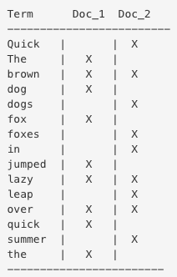
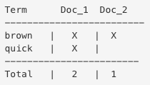
Inverted Index
The quick brown fox jumped over the lazy dog
Quick brown foxes leap over lazy dogs in summer
Search: “quick brown”

Slide 22
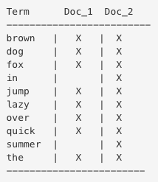
Inverted Index cont…
Lower case the words (terms) The > the
Stem-reduce foxes > fox
Synonyms: jump / leap > jump
Both indexed text and query string must be normalized into the same form
This is analysis

Slide 23
Queries and Filters
Elasticsearch provides a full Query DSL based on JSON to define queries
Query context:
How well does this document match this query clause?
Each document is scored
Filter context:
Does this document match this query clause?
No score applied – if document does not match it is excluded
Think of SQL WHERE= clause
Tip: Applying filters correctly will have a huge impact on performance

Slide 24
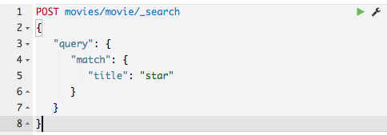
A simple query
Why does Episode 4 score lower? Explain yourself Elasticsearch!

Slide 25
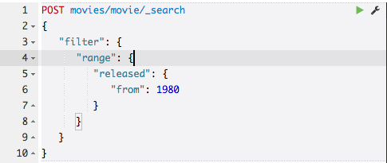
A simple filter
What about the scores?

Slide 26
Scoring in Elasticsearch
Elasticsearch uses the Boolean model to find matching documents, and a formula called the practical scoring function to calculate relevance
Is is based on the following:
Term frequency - how often does the term appear in this document?
Inverse document frequency - how often does the term appear in all documents in the collection?
Field-length norm - how long is the field? The shorter the field, the higher the weight
It is possible at index time to control which of these to apply
It is also possible to perform custom scoring at query time using scripts

Slide 27
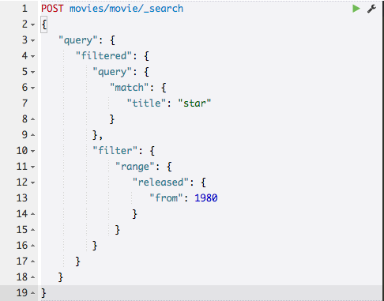
Putting them together

Slide 28
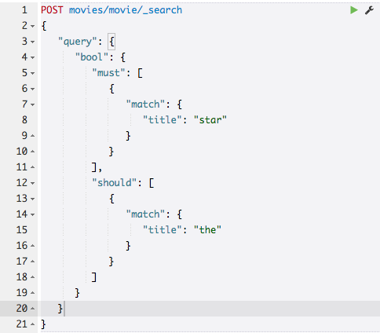
Combining queries

Slide 29
Loading data into Elasticsearch
Direct API posts
Bulk API
Logstash
JDBC Importer (replaces “rivers”)
ogr2ogr
Elasticsearch official SDKs
Third party libraries
Roll your own!

Slide 30
Let’s go to the movies
Import the movies.csv file using the JDBC importer
Note, the version of the loader must match the version of Elasticsearch or bad things can happen!
Note the default mapping, not very useful
Some fields are not very useful to us either
Let’s amend and try again
We have a number of data types available: https://www.elastic.co/guide/en/elasticsearch/reference/current/mapping-types.html

Slide 31
Exercises
Find all movies about fish, find all movies about fishes
Find all movies made between 1980 and 1989
Find all movies about fish made in 1988
Find all action movies less than 90 minutes long
Find all action movies with a budget of greater than $100m
Find all star wars films but not the Phantom Menace
Find all films with an mpaa rating of “PG”
Find all films with the title “zigzag”, now try “zig zag”
Find all films called “Blood Money”

Slide 32
Controlling Analysis
Strings are analyzed by default
For terms such as the mpaa rating we do not want this
We can specify how the the mappings are defined at index time
We can also control how tokenizing works so we could look for “ZigZag” and break out to “Zig Zag” at index time
Let’s re-index

Slide 33
And/Or
If we search for “Blood Money” we get all films with “Blood” or “Money” in the title
We can control this at query time in a number of ways:
Operator: and/or
minimum_should_match

Slide 34
Dealing with Order
We would expect a film called “Dirty Dancing” to score higher than one called “Dancing Dirty”
However a match query does not distinguish between term order by default
We have a number of options:
Match phrase
Shingles

Slide 35
Multi Match Queries
In addition to the bool query, Elasticsearch provides the multi-match query as a short-hand:
best_fields: (default) Finds documents which match any field, but uses the _score from the best field
most_fields: finds documents which match any field and combines the _score from each field.
cross_fields: treats fields with the same analyzer as though they were one big field. Looks for each word in any field
phrase: runs a match_phrase query on each field and combines the _score from each field
phrase_prefix: runs a match_phrase_prefix query on each field and combines the _score from each field

Slide 36
Dealing with Language
We saw with the “fish” / “fishes” example that elasticsearch does not recognise common linguistic features such as plurals by default
Using a “stemmer” combined with common “stop words” can help greatly
Elasticsearch has many language analyzers available, these are presets: combinations of stemmers and stop words that are optimised for a certain language

Slide 37
Fuzzy Logic
The fuzzy query uses similarity based on Levenshtein edit distance for string fields, and a +/- margin on numeric and date fields
Fuzziness can be the number of replacements or AUTO
An optional prefix_length can be applied, this helps enormously with performance!

Slide 38
Ordering Results
By default results are returned in descending order of score
We can control the ordering by applying a custom order
Note that ordering results can be expensive so use with caution
Beware using analysed fields in the order as results can be unusual
Multi field at analysis time can overcome these issues (use a .raw field)

Slide 39
Aggregations
Aggregations are a powerful feature of Elasticsearch and drive many analytical use cases
If well designed aggregations can be very fast operating across multiple servers, shards and indexes
We will explore a simple example here however there are some excellent tutorials available that explore this in more depth
It is also possible to perform geographic aggregations on geohash and geodistance which could be used to provide server side clustering capability to web applications

Slide 40
Geo Support
Elasticsearch has supported geo since it’s earliest days
It supports two types:
Geo-points allow you to find points within a certain distance of another point, to calculate distances between two points for sorting or relevance scoring, or to aggregate into a grid to display on a map
Geo-shapes, are used purely for filtering. They can be used to decide whether two shapes overlap, or whether one shape completely contains other shapes
We will be focussing on the geo_point datatype today but will use a geo_shape to perform a query against a point layer

Slide 41
Geo Point
There are four ways of expressing a geo-point in Elasticsearch: object, string, geohash or array
Somewhat confusingly, strings are express “lat,lon” whereas arrays are [lon,lat] – we will be using the object format to avoid ambiguity
In previous versions of Elasticsearch it was necessary to fine tune the indexing to achieve acceptable performance however since v2.x the defaults should be fine for most use cases
Geo indexes were previously memory intensive however with 2.x and the move to doc values by default good performance can be achieved with disk
For details of the inner workings of the geo types the following article is recommended: https://www.elastic.co/blog/supercharging-geopoint

Slide 42
Geo Point Parameters
geohash - Should the geo-point also be indexed as a geohash in the .geohash sub-field?
geohash_precision - The maximum length of the geohash to use for the geohash and geohash_prefix
geohash_prefix - should the geo-point also be indexed as a geohash plus all its prefixes?
ignore_malformed - if true, malformed geo-points are ignored. If false (default), malformed geo-points throw an exception and reject the whole document
lat_lon - should the geo-point also be indexed as .lat and .lon sub-fields? Accepts true and false (default)
Note: using lat_lon can give a good perfomance uplift on geo_bounding_box and geo_distance queries and is recommended even though not the default

Slide 43
Let’s load some geo data!
We will use the geonames cities15000 dataset
We will need to add a header record to get the csv loader to work
We also need to provide the column datatypes as before
We need to defined mappings for the geo_point to be able to work with this
We also need to query the csv file to return location.lat and location.lon mappings

Slide 44
Bounding Box Filtering
A query allowing to filter hits based on a point location using a bounding box
The simplest and fastest of the Geo filters available
The bounding box is specified as a top_left and bottom_right object
Options:
ignore_malformed - set to true to accept geo points with invalid latitude or longitude (default is false)
type - set to one of indexed or memory to defines whether this filter will be executed in memory or indexed
If we have set lan_lon=true in our mapping we should set type=indexed to get the performance uplift

Slide 45
Geo Distance Filtering
Filters documents that include only hits that exists within a specific distance from a geo point
In the same way the geo_point type can accept different representation of the geo point, the filter can accept it as well
Accepts the following options:
distance: the radius of the circle centred on the specified location, can be expressed in various units
distance_type: how to compute the distance. Can either be sloppy_arc (default), arc (slightly more precise but significantly slower) or plane (faster, but inaccurate on long distances and close to the poles)
optimize_bbox: whether to use the optimization of first running a bounding box check before the distance check
ignore_malformed: as before with indexing, default is false

Slide 46
Geo Polygon Filtering
A query allowing to include hits that only fall within a polygon of points
Options are as with bounding box
Accepts an object representing a series of points from which a polygon is contrsucted
This kind of query is very expensive in Elasticsearch currently!
Work is underway to optimise the handling of shapes in Elasticsearch and it is is likely in the future that the geo_point and geo_shape mappings will undergo considerable work and will very likely be merged

Slide 47
Sorting by Distance
Search results can be sorted by distance from a point
Options are:
order – asc or desc
unit – m, km etc
distance_type - how to compute the distance. Can either be sloppy_arc (default), arc (slightly more precise but significantly slower) or plane (faster, but inaccurate on long distances and close to the poles).
Scoring by Distance is usually a better solution for this kind of requirement however this requires an in-depth look at custom scoring and is out of the scope of this workshop

Slide 48
Exercises
Experiment with running the various different types of geo filters and geo sorts we have covered
Combine these with the full text queries we learnt previously
This is the power of Elasticsearch and the real ue case we are exploring: the combination of advanced full text searching and geo to deliver near real-time results!

Slide 49
Hackathon
Work in pairs, ideally at least one developer to each pair
Build a simple application using the Elasicsearch API to display results on the map for the geonames data
Be prepared to present your results
There are no prizes except the glory and admiration of your colleagues!

Slide 50
Top Tip: Type Ahead (Auto Complete)
There are a number of ways of achieving this
Prefix queries will work but are slow
Completion suggester is highly optimised and makes use of memory
nGrams provide a good solution but need to be considered at index time

Slide 51
Top Tip: Production Optimisation
Config file tweaks
Warmers API
Disable refresh for big indexing jobs
Use the bulk API for large loads
Optimize API
Avoiding split brain
Load balancing
Excluding superfluous fields
Use prefix with fuzzy logic
Securing behind a proxy

